Slide 1

Ho Chi Minh City University of Transport
Image Processing and Computer Vision
Edge Detection and Linking
Tran Le Anh
anhtl@ut.edu.vn
04-2025

Slide 2
Edge Detection
Canny Edge Detector
Edge Linking

Slide 3
Edge Detection
Canny Edge Detector
Edge Linking

Slide 4
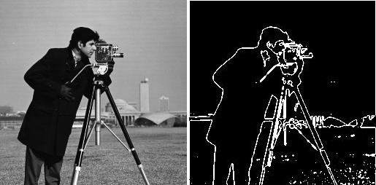
Edge Detection
Concept
- Edge detection is a fundamental technique in image processing and computer vision that aims to find the outlines or boundaries of objects within an image.
- Edge detection identifies regions where the intensity of pixels changes rapidly, indicating a boundary between different objects or regions.
Original
Edges

Slide 5
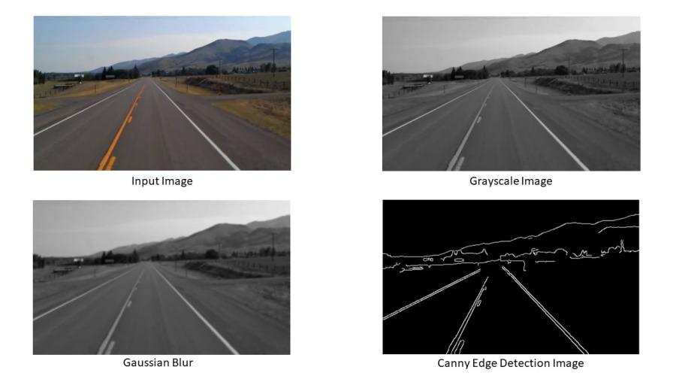
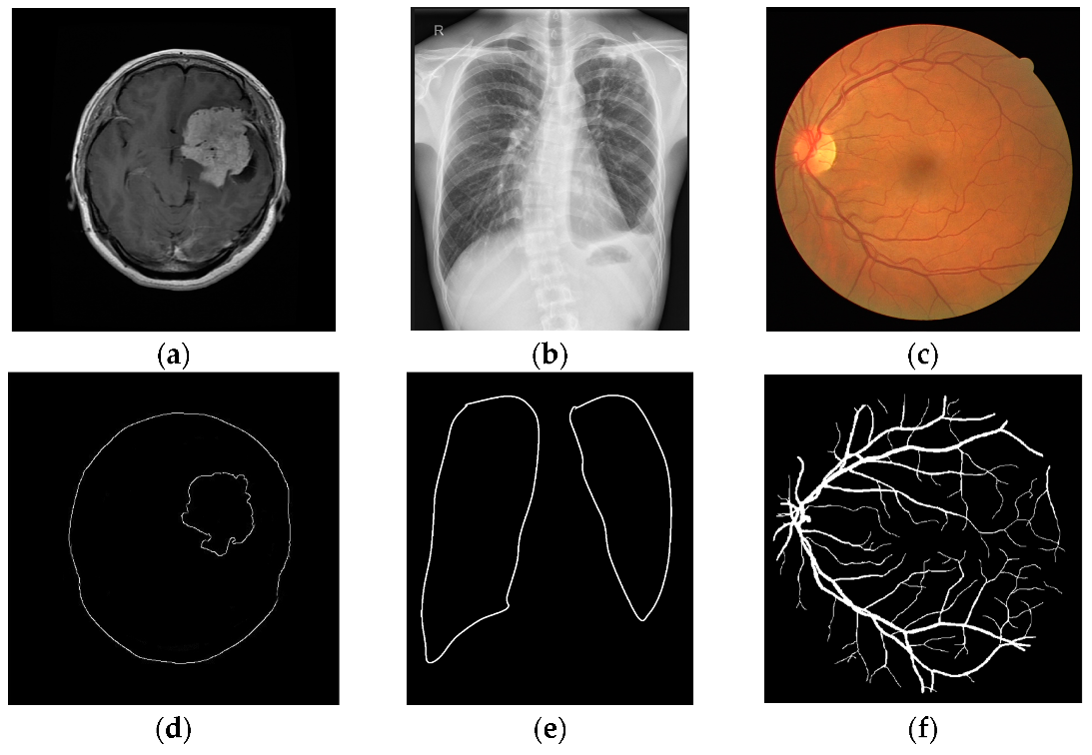
Edge Detection
Why is it Important?
- Edges represent object boundaries, shapes, or transitions, critical for understanding image content.
- Foundation for many computer vision tasks: object detection, segmentation, feature extraction.
- Applications: Autonomous vehicles, medical imaging, facial recognition, robotics.
Advanced Driver-Assistance Systems (ADAS)
Medical Imaging Analysis

Slide 6
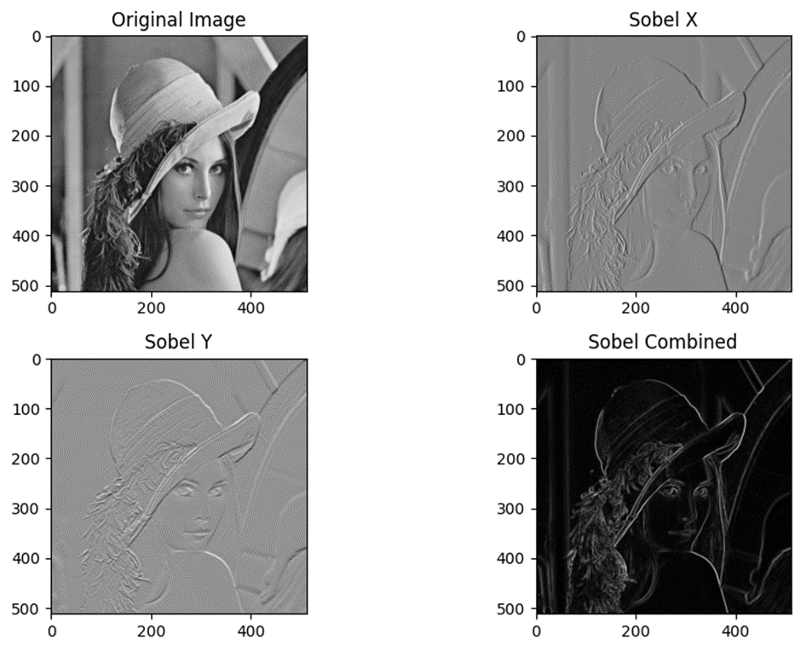
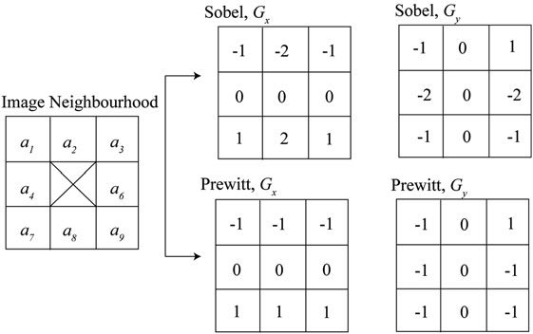
Edge Detection
Techniques
- First-Order Derivative Methods: Sobel Operator, Prewitt Operator, etc.
- Second-Order Derivative Methods: Laplacian of Gaussian (LoG), Difference of Gaussians (DoG), etc.
- Canny Edge Detector

Slide 7
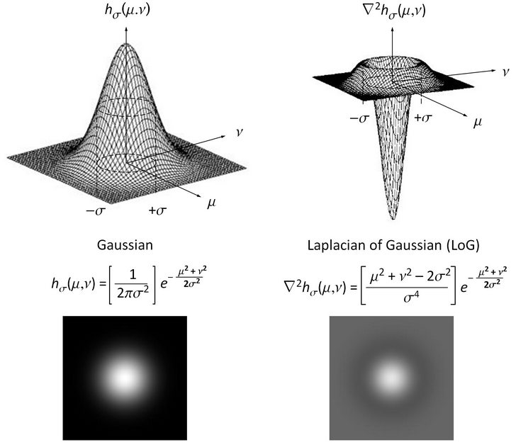
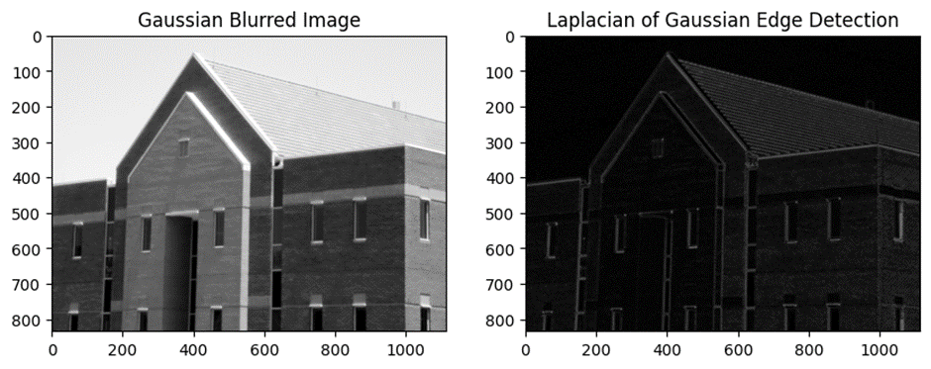
Edge Detection
Techniques
- First-Order Derivative Methods: Sobel Operator, Prewitt Operator, etc.
- Second-Order Derivative Methods: Laplacian of Gaussian (LoG), Difference of Gaussians (DoG), etc.
- Canny Edge Detector

Slide 8
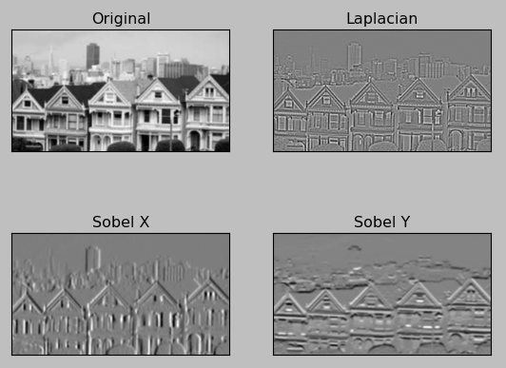
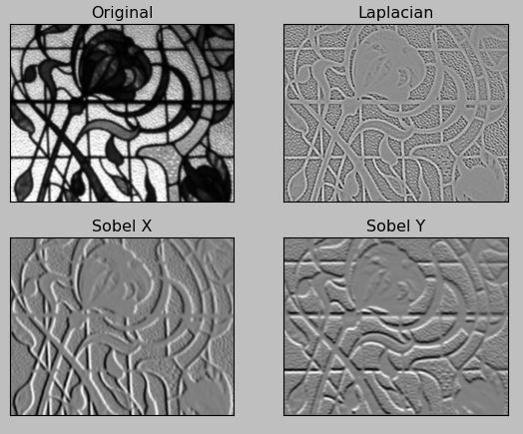
Edge Detection
Techniques
- First-Order Derivative Methods: Sobel Operator, Prewitt Operator, etc.
- Second-Order Derivative Methods: Laplacian of Gaussian (LoG), Difference of Gaussians (DoG), etc.
- Canny Edge Detector
Ref: Image Edge Detection : Sobel and Laplacian

Slide 9
Edge Detection
Canny Edge Detector
Edge Linking

Slide 10
Canny Edge Detector
Process
- Noise Reduction: Apply Gaussian blur.
- Gradient Computation: Use Sobel kernels to find edge strength and direction.
- Non-Maximum Suppression: Thin edges by suppressing non-maximum gradient values.
- Double Thresholding: Classify edges as strong, weak, or non-edges.
- Edge Tracking: Connect weak edges to strong ones using hysteresis.

Slide 11
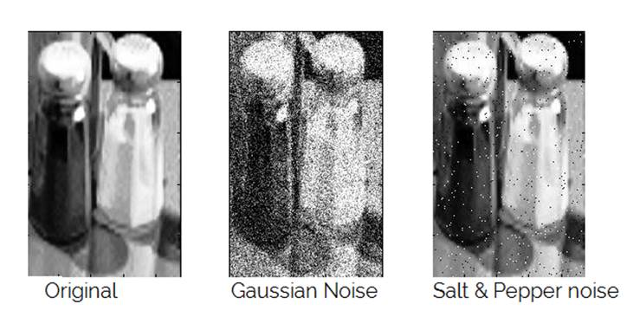
Canny Edge Detector
Noise Reduction
Why Noise Reduction?
- Edge detection identifies sharp intensity changes in an image, but noise also creates these sharp changes.
→ Get false edges caused by noise.
Ref: https://devendrapratapyadav.github.io/Fuzzy_Image_processing/

Slide 12



Canny Edge Detector
Noise Reduction
Apply a Gaussian blur to the image to reduce noise because edge detection is sensitive to noise.
1 | 4 | 7 | 4 | 1
4 | 16 | 26 | 16 | 4
7 | 26 | 41 | 26 | 7
4 | 16 | 26 | 16 | 4
1 | 4 | 7 | 4 | 1
1
273
Original
Gray
Gaussian Blur

Slide 13

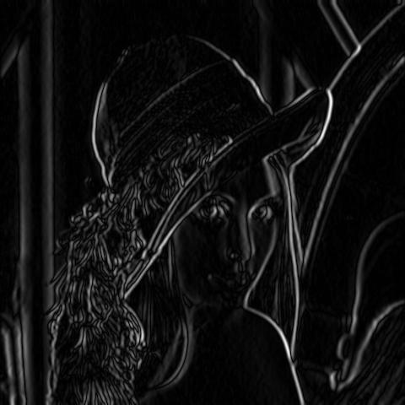
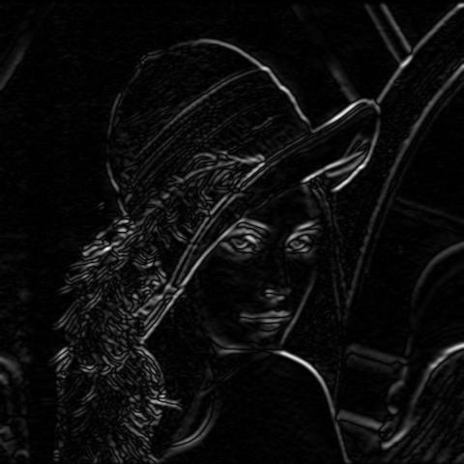
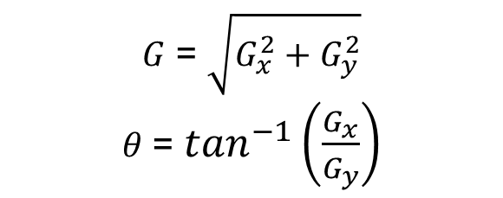


Canny Edge Detector
Gradient Computation
Use Sobel operators to find intensity gradients in the image.
Gradient Magnitude
$$G_{x}$$
-1 | 0 | 1
-2 | 0 | 2
-1 | 0 | 1
$$G_{y}$$
1 | 2 | 1
0 | 0 | 0
-1 | -2 | -1
$G$ = $\sqrt{G_{x}^{2}+G_{y}^{2}}$
$θ$ = $\tan^{−1}\left(\frac{G_{x}}{G_{y}}\right)$
Gaussian Blur

Slide 14
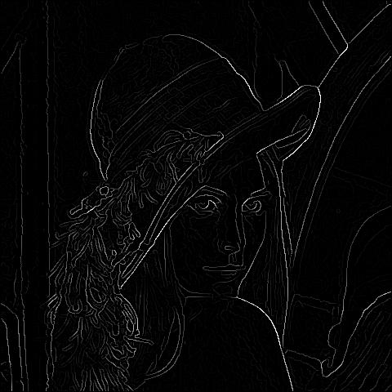
Canny Edge Detector
Non-Maximum Suppression
The magnitude image produced results in thick edges, while the final image should have thin edges. Thus, non-maximum suppression is applied to thin out the edges.
Gradient Magnitude
Non-maximum Suppression

Slide 15
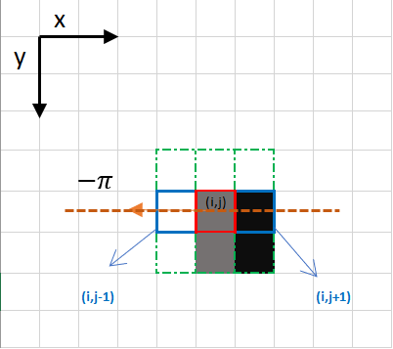
Canny Edge Detector
Non-Maximum Suppression
- Assuming that the edge direction is the orange dotted line, this step is to check if the pixels on the same direction are more or less intense than the one being processed.
- The red pixel is being processed, and the pixels on the same direction are highlighted in blue. The most intense pixel is kept, the rest are removed.
Gradient Magnitude
Non-maximum Suppression

Slide 16
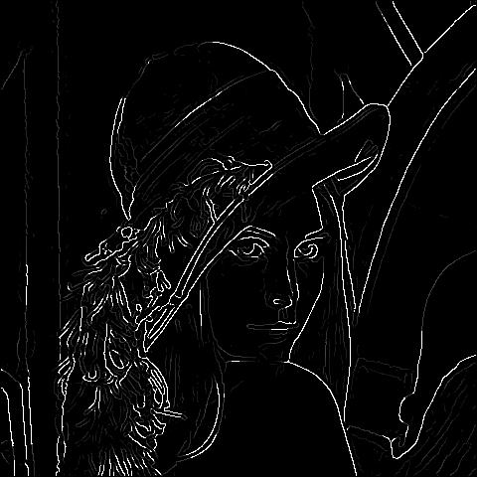
Canny Edge Detector
Double Thresholding
- Apply two thresholds: a high and a low.
- Pixels with gradient > high threshold are considered strong edges.
- Pixels between low and high are considered weak edges.
- Pixels below low threshold are suppressed.
Non-maximum Suppression
Thresholding

Slide 17
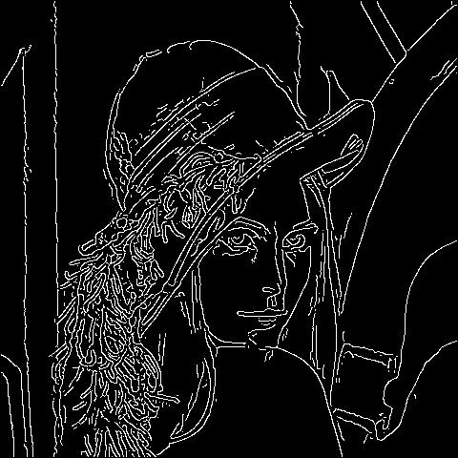
Canny Edge Detector
Edge Tracking by Hysteresis
- Final step connects weak edges to strong edges if they are connected.
- Weak edges that are connected to strong edges will be real edges.
- Weak edges that are not connected to strong edges will be removed.
Thresholding
Edge Tracking

Slide 18
Canny Edge Detector
Recap
Original
Gray & Blur
Gradient Magnitude
Non-maximum
Suppression
Thresholding
Hysteresis Tracking

Slide 19
Edge Detection
Canny Edge Detector
Edge Linking

Slide 20
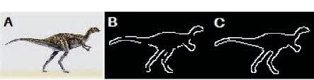
Edge Linking
Concept
- Edge linking in image processing is the process of connecting discrete edge points identified by edge detection algorithms into continuous lines or curves.
- This helps to improve the accuracy and robustness of edge detection by grouping together nearby edge pixels that likely belong to the same boundary.

Slide 21
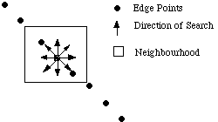

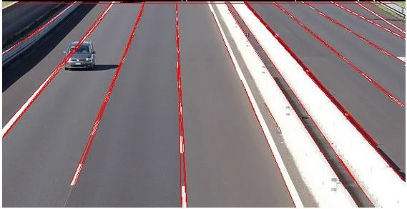
Edge Linking
Techniques
- Local Edge Linking: edge points are grouped to form edges by considering each point's relationship to neighbouring edge points.
- Global Edge Linking: edge points in the image plane are considered at the same time and sets of edge points are sought according to some similarity constraint, such as points which share the same edge equation.
Hough Transform
Ref: Edge Linking

Slide 22
Edge Detection and Linking
Practice
- Canny Edge Detector

Slide 23
Thank You
anhtl@ut.edu.vn

